Slide 1
Data Collection and Coursework 1
Principles and Design of IoT Systems

Slide 2
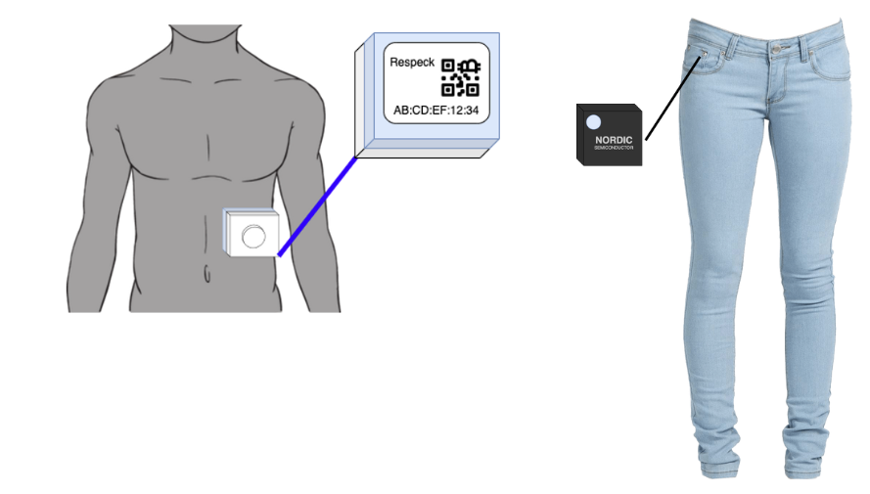
Coursework 1 Task Summary
In this coursework, you will use the wearable devices Thingy and RESpeck (which are connected to the PDIoT app) while engaging in various physical activities and run code to preprocess the data you have collected so that it is ready to be used in Coursework 3.

Slide 3
Activities to be recorded
You will have to perform a series of activities while wearing the sensor. Each activity should be performed for 30(±2) seconds.
14 Physical activities - done while wearing the RESpeck and Thingy
Sitting, standing, lying down on your left side, lying down on your right side, lying down on your back, lying down on your stomach, walking normally, ascending stairs, descending stairs, shuffle walking, running/jogging, and miscellaneous movements while breathing normally.

Slide 4
Activities to be recorded
12 Stationary activities with respiratory responses - done while wearing the RESpeck only
Sitting, standing, lying down on your left side, lying down on your right side, lying down on your back, and lying down on your stomach while coughing and hyperventilating.
20 Stationary activities with other behaviors - done while wearing the RESpeck
Sitting and standing while talking, eating, singing, and laughing.
Lying down on back, lying down on left side, lying down on right side, and lying down on stomach while talking, singing, and laughing.

Slide 5
Data Preprocessing and Cleaning
Ensure that you have a total of 46 recorded activities (60 recorded data files)
28 data files for the physical activities
12 data files for the stationary activities with respiratory responses
20 data files for stationary activities with other behaviors
Ensure that each of your data files is 30(±2) seconds long/
Ensure that each of your data files has a sampling rate of 25 Hz.
Ensure that there are no unnecessary gaps of inactivity in your data recordings.
Ensure that only ONE activity is being performed in each of your data recordings.
Visually verify your recordings so that activity starts at the very beginning and stops at the very end of the recording

Slide 6
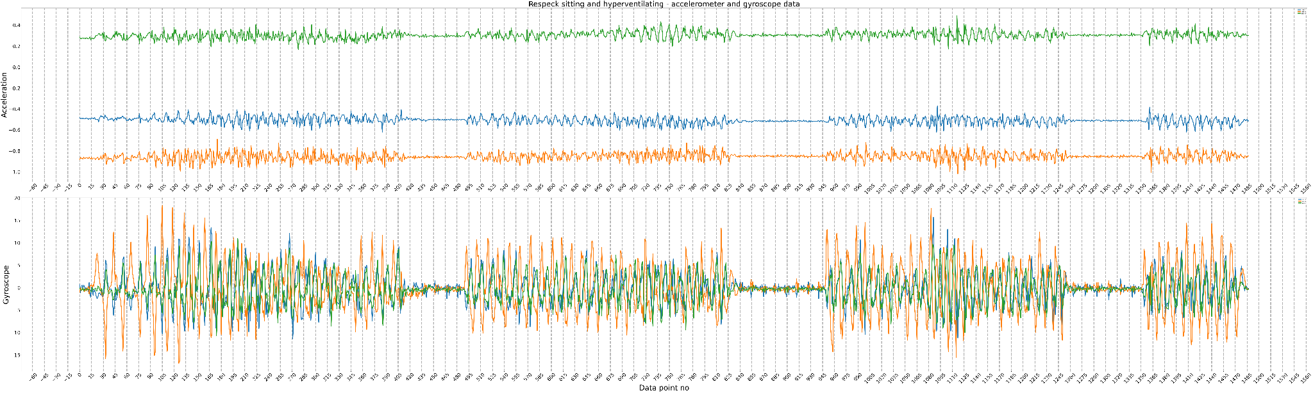
Example - raw unprocessed data
Respeck sitting and hyperventilating

Slide 7
Example - raw unprocessed data
Respeck sitting and hyperventilating

Slide 8
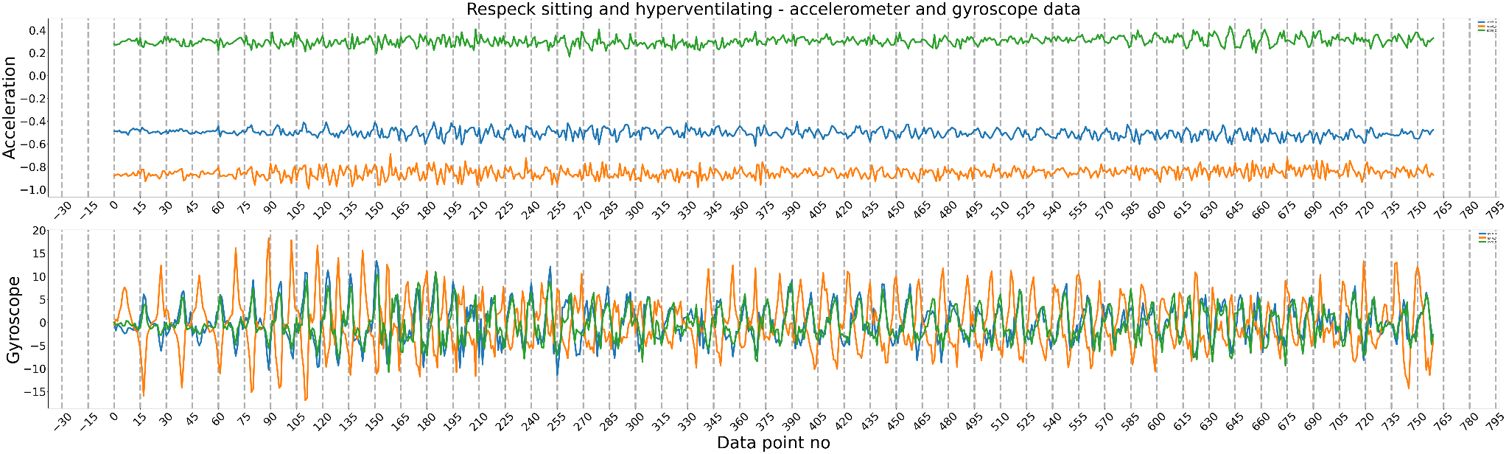
Example - cleaned and trimmed data
Respeck sitting and hyperventilating

Slide 9
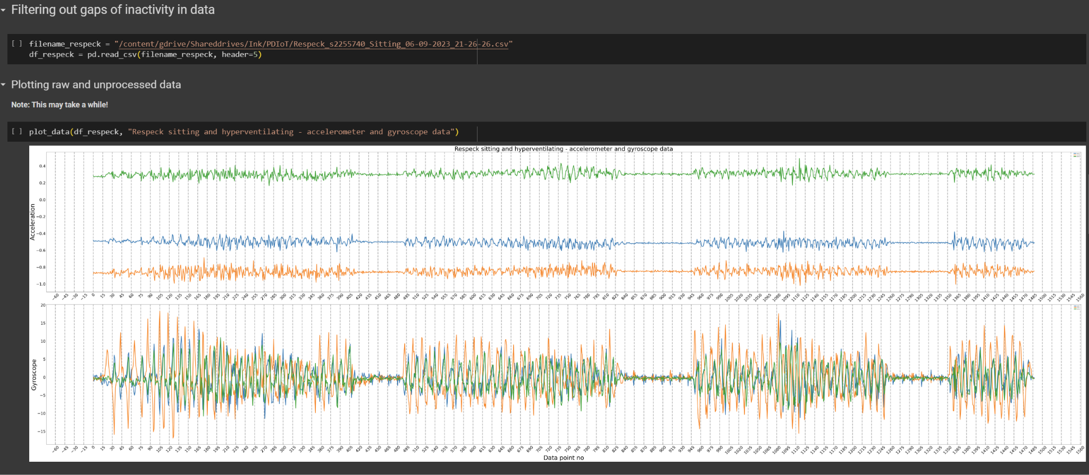
Data cleaning process

Slide 10
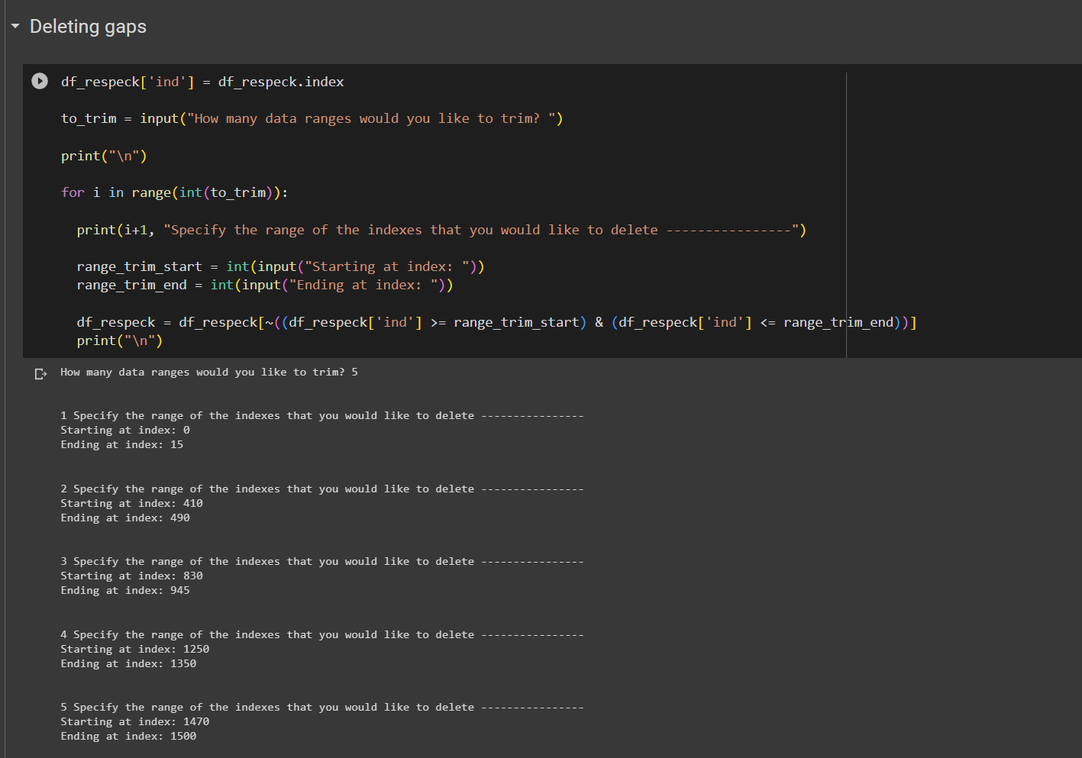

Slide 11
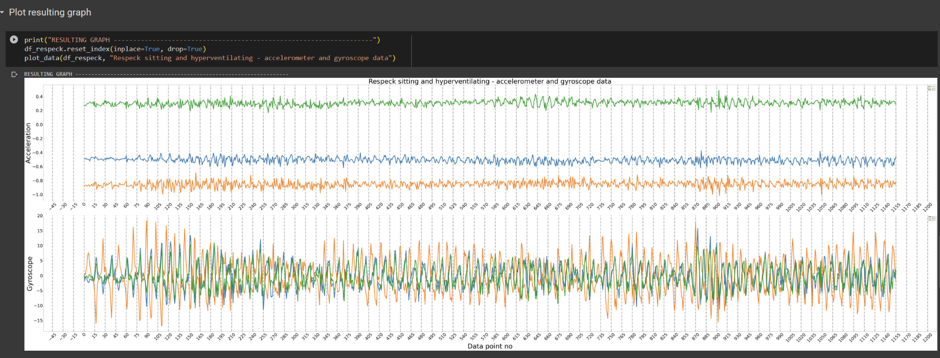

Slide 12
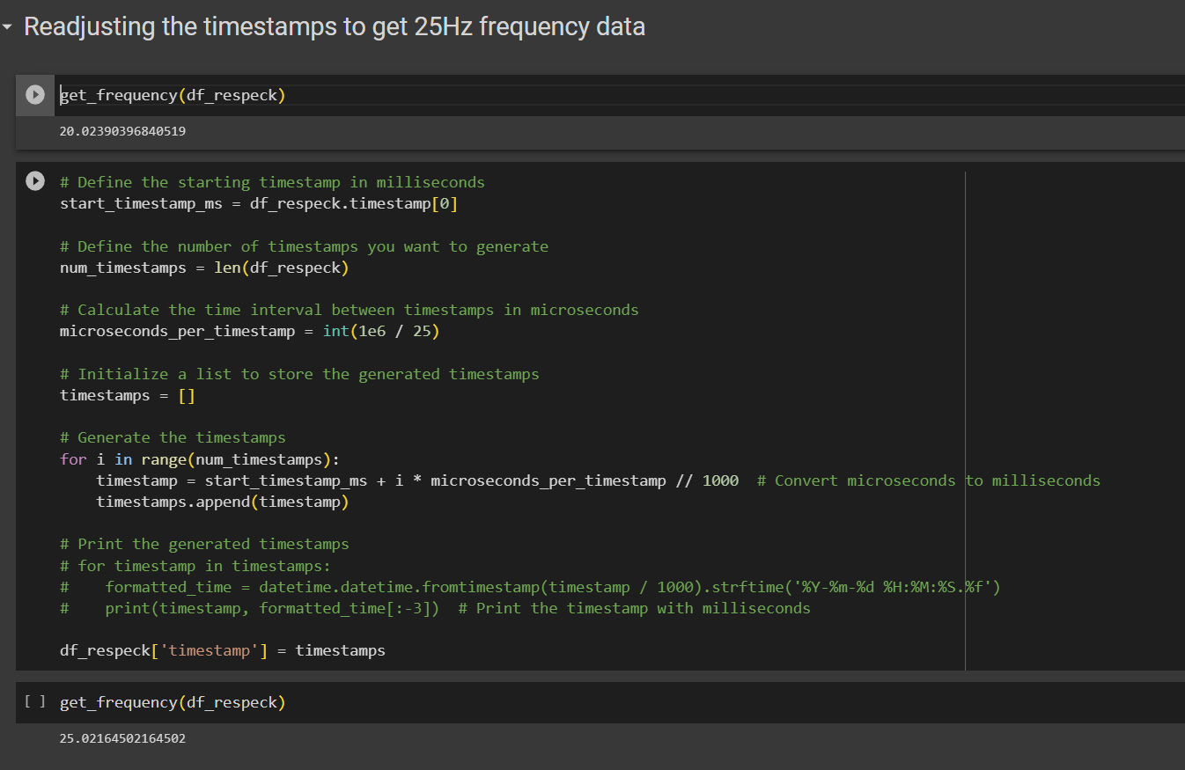

Slide 13
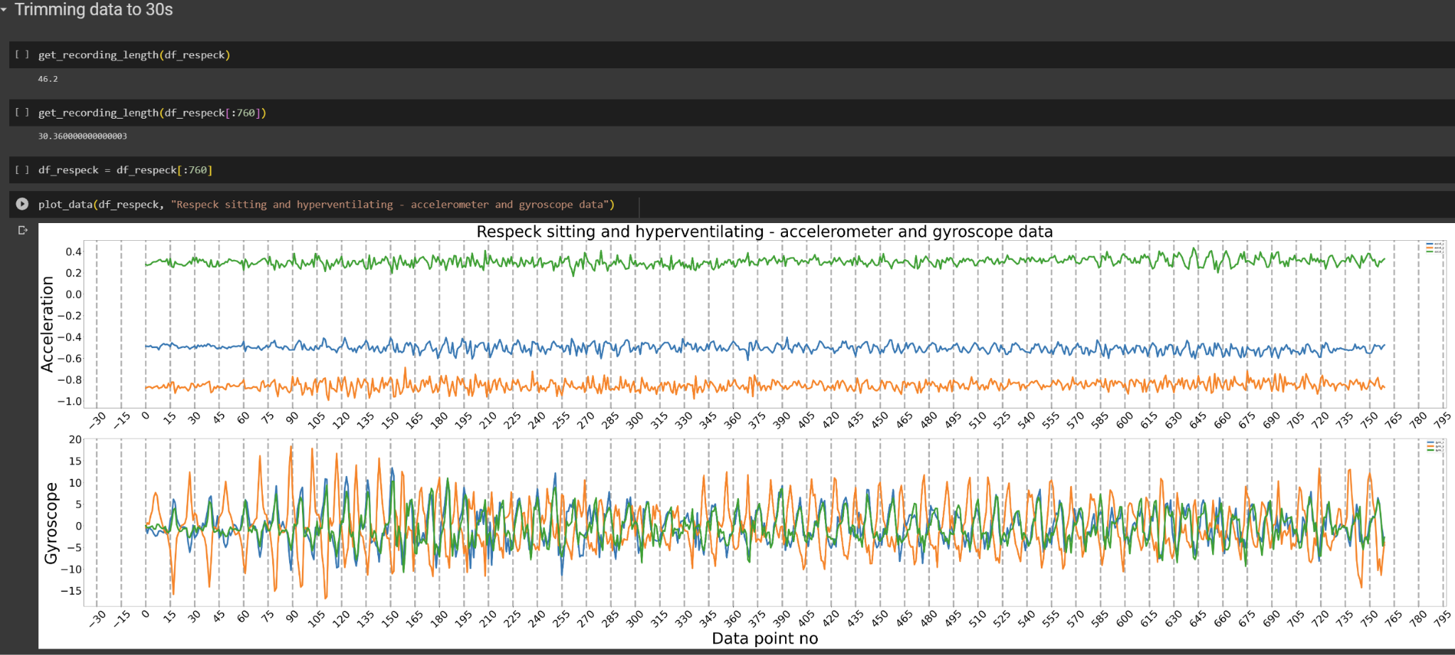

Slide 14
Submission
You should submit both your clean and unprocessed (original) data files to the PDIoT GitHub repository.
More details on the submission guidelines can be found in the Coursework 1 document.

Slide 15
Resources
All resources to complete Coursework 1 can be found in:
Lab 1.1 Instructions - Connecting sensors to the mobile app
Lab 1.2 Instructions - Collecting physical activity data
Lab 2 Instructions - Data collection protocol: data cleaning and trimming
Lab 2 Python Notebooks for visualizing and cleaning data
Coursework 1 Document
All materials will be made available on Learn and the PDIoT website.

